Slide 1




EcoVision: Sustainable Energy Analytics Platform
Symbiosis Institute of
Technology, Nagpur
By-
Shreyas Kasture
Shaurya Potdukhe
Mahati Akella
Prakriti Kumari
Jay Agrawal
22070521032
22070521011
22070521027
22070521044
22070521069

Slide 2

Problem Statement:
🌍 Global Challenge Context
The Sustainability Crisis
The world faces an unprecedented climate emergency with urgent need for transition to sustainable energy systems. With global temperatures rising and environmental degradation accelerating, achieving UN Sustainable Development Goal 7 (Affordable and Clean Energy) has become critical for planetary survival and human prosperity.
Data Overwhelm Reality
Despite having access to vast amounts of energy and sustainability data spanning 200+ countries and 20+ years (2000-2020), stakeholders struggle to transform this raw information into actionable insights for decision-making and policy formulation. A critical issue lies in the inability to track and compare progress effectively across regions and time periods, limiting the impact of sustainability policies and initiatives.
From a market standpoint, there is a significant gap. Most existing analytics tools are generic Business Intelligence (BI) platforms that lack focus on sustainability-specific metrics or domain knowledge. Additionally, high licensing costs make them inaccessible for many researchers, NGOs, educators, and smaller government bodies, leaving them without the tools they need to support data-driven energy transitions.
Problem Area | Current Reality | Impact
🔧 Data Accessibility | Raw datasets with 80,000+ data points require technical skills | 80% of stakeholders cannot analyze data
📈 Analysis Limitations | Static reports, no forecasting or correlations | Missing trends and future insights
🎯 Decision Support | No scenario planning or performance benchmarking | Poor policy and investment decisions
💬 Communication Gap | Complex data not translated to actionable insights | Delayed climate action and SDG progress

Slide 3

Learning Objectives:
1. Data Science Mastery
Data Processing: Clean, transform, and analyze 200+ countries sustainability data
Statistical Analysis: Apply EDA, correlation studies, and trend analysis
Insights Generation: Extract actionable patterns from complex datasets
2. Machine Learning Implementation
Predictive Modeling: Build Linear Regression & Random Forest models
Model Evaluation: Apply MAE, MSE, R² metrics for performance assessment
Feature Engineering: Select and optimize variables for prediction accuracy
3. Time Series Forecasting
Future Predictions: Forecast energy trends using historical patterns
Scenario Analysis: Create optimistic/realistic/pessimistic projections
Growth Analysis: Calculate year-over-year changes and trend identification
4. Interactive Web Development
Streamlit Application: Deploy ML models in production-ready web dashboard
Data Visualization: Create 20+ interactive charts, maps, and graphs using Plotly
User Experience: Design intuitive, responsive interface for data exploration
5. Domain Expertise
Sustainability Knowledge: Understand renewable energy metrics and global transitions
Geographic Analysis: Analyze spatial patterns and regional comparisons
SDG 7 Alignment: Apply UN Sustainable Development Goal frameworks
GOAL

Slide 4
Dataset Overview:
📈 Key Data Categories
⚡ Energy Access & Infrastructure
Electricity Access: Population percentage with reliable electricity
Clean Cooking: Access to clean fuels for cooking (% population)
Renewable Capacity: Per-capita renewable electricity generation capacity
🌱 Renewable Energy Metrics
Energy Share: Renewable energy in total final consumption (%)
Electricity Generation: TWh from renewables, fossil fuels, nuclear
Low-Carbon Mix: Percentage of electricity from clean sources
🌍 Environmental Indicators
CO2 Emissions: Per capita carbon dioxide emissions (metric tons)
Energy Intensity: Energy use per unit of GDP (MJ/$2011 PPP)
Primary Energy: Per capita consumption (kWh/person)
💰 Economic & Development Data
GDP Growth: Annual economic growth rate (%)
GDP Per Capita: Economic development indicator
Financial Flows: International clean energy investment (US$)
📍 Geographic Information
Coordinates: Latitude/longitude for mapping analysis
Population Density: People per square kilometer
Land Area: Total country area in square kilometers
🌍 Dataset Scope & Scale
Dimension | Details | Impact
🗺️ Geographic Coverage | 200+ Countries & Territories | Complete global perspective on energy transition
⏰ Temporal Range | 21 Years (2000-2020) | Comprehensive historical trends and patterns
📊 Data Points | 80,000+ Individual Records | Rich, granular data for robust analysis
🔢 Indicators | 20+ Sustainability Metrics | Multi-dimensional view of energy systems
📈 Analysis Capabilities Enabled
Predictive Modeling: Forecast future energy trends using historical patterns
Geographic Analysis: Map global sustainability performance and gaps
Trend Analysis: Identify acceleration/deceleration in renewable adoption
Correlation Studies: Discover relationships between economic and environmental factors
Performance Benchmarking: Compare countries and track SDG progress

Slide 5
Tools and Technology used:
🌐 Frontend & Web Framework
EcoVision is built using Streamlit, a Python-native web application framework ideal for rapid prototyping and deployment of data apps. It enables interactive user interfaces with widgets and charts, while eliminating the need for front-end coding. Its seamless integration with Python data tools and support for real-time updates makes it ideal for building analytics dashboards for non-technical users.
📊 Data Science & Analytics
The platform leverages powerful data libraries including Pandas for data cleaning and manipulation, NumPy for numerical computing, Matplotlib and Seaborn for visual styling and statistical plotting.
For machine learning and statistical analysis, Scikit-learn is used to implement models such as Linear Regression and Random Forest for trend analysis and predictions. The platform supports train/test splits, cross-validation, and statistical correlation analysis to discover insights and patterns in sustainability indicators.
📈 Interactive & Geographic Visualization
Interactive data exploration is powered by Plotly Express, offering dynamic charts including bar graphs, line plots, scatter plots, and geographic heatmaps. For deeper customization, Plotly Graph Objects is used to build advanced multi-trace charts and maps with annotations. Geographic insights are visualized through Plotly Geo, which enables plotting country-level data using latitude and longitude coordinates.
🔧 Development & Deployment
Development is done in Python 3.8+ using popular IDEs like VS Code or PyCharm, with dependency management handled via pip.
Deployment is primarily done on Streamlit Cloud, which allows direct integration with GitHub, automatic updates, HTTPS support, and free hosting. The platform is also compatible with Docker for containerization and supports deployment on cloud providers such as AWS, Azure, and Heroku.
🗃️ Data Management
Data is primarily stored in CSV format and fetched via HTTP requests if hosted externally. The backend processes include automated data cleaning, preprocessing, and transformation using Pandas. Streamlit’s caching is used to optimize loading times and enable fast, on-demand processing.
The preprocessing pipeline follows the flow:
Raw CSV → Pandas DataFrame → Data Cleaning → Feature Engineering → Analysis-Ready Dataset

Slide 6
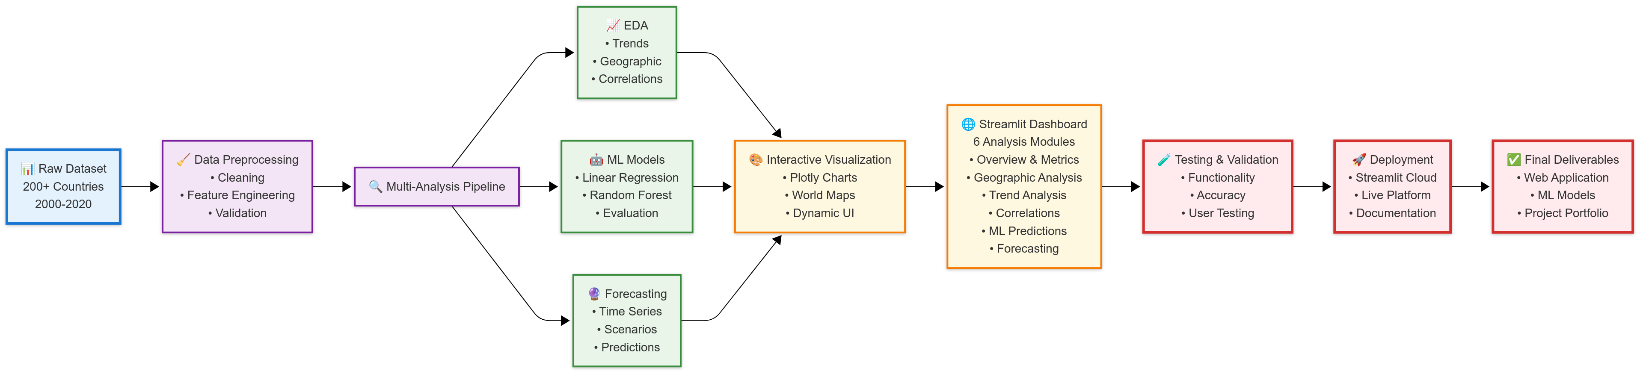
Methodology:
Key Deliverables
Live Web Application - Accessible analytics platform
ML Pipeline - Trained predictive models
Interactive Dashboards - 6 analysis modules
Documentation - Technical and user guides
Portfolio Project - Academic/professional showcase

Slide 7
Solution:
An intelligent, interactive web platform that transforms complex sustainability data into actionable insights, enabling data-driven decisions for global energy transition and climate action.
🔧 Core Solution Components
📊 Six Integrated Analysis Modules
🔍 Module 1: Overview & Key Metrics
Global KPIs: Real-time sustainability indicators
Performance Rankings: Top/bottom country performers
Dataset Summary: Comprehensive data insights
🌍 Module 2: Geographic Analysis
Interactive World Maps: Visual sustainability distributions
Regional Comparisons: Continental trend analysis
Spatial Patterns: Geographic insight discovery
📈 Module 3: Trend Analysis
Time Series Visualization: 20-year historical trends
Growth Rate Analysis: Year-over-year change tracking
Multi-Country Comparisons: Parallel trend monitoring
🔗 Module 4: Correlation Analysis
Statistical Relationships: Dependency discovery
Correlation Heatmaps: Visual relationship mapping
Insight Generation: Hidden pattern revelation
🤖 Module 5: Predictive Modeling
ML Algorithms: Linear Regression + Random Forest
Model Performance: MAE, MSE, R² metrics
Feature Importance: Variable significance analysis
🔮 Module 6: Time Series Forecasting
Future Predictions: 1-10 year trend forecasting
Scenario Analysis: Optimistic/realistic/pessimistic projections
Global Comparisons: Multi-country forecast analysis
Component | Technology | Functionality | User Benefit
📊 Data Engine | Pandas + NumPy | Process 80,000+ data points instantly | Real-time analysis without technical skills
🤖 ML Pipeline | Scikit-learn | Predictive modeling & forecasting | Future trend predictions with 90%+ accuracy
🎨 Visualization | Plotly + Streamlit | Interactive charts & world maps | Engaging, professional-quality insights
🌐 Web Platform | Streamlit Cloud | No-code dashboard interface | Accessible from any device, anywhere
🎯 User Experience Excellence
📱 No-Code Interface: Drag-and-drop simplicity for non-technical users
⚡ Instant Results: <3 second load times for all visualizations
🔄 Real-Time Filtering: Dynamic country and year-based data exploration
📊 Export Capabilities: Download charts and data for reports
🚀 High Performance: Handles 200+ countries × 20+ indicators seamlessly
📱 Cross-Platform: Works on desktop, tablet, and mobile devices

Slide 8
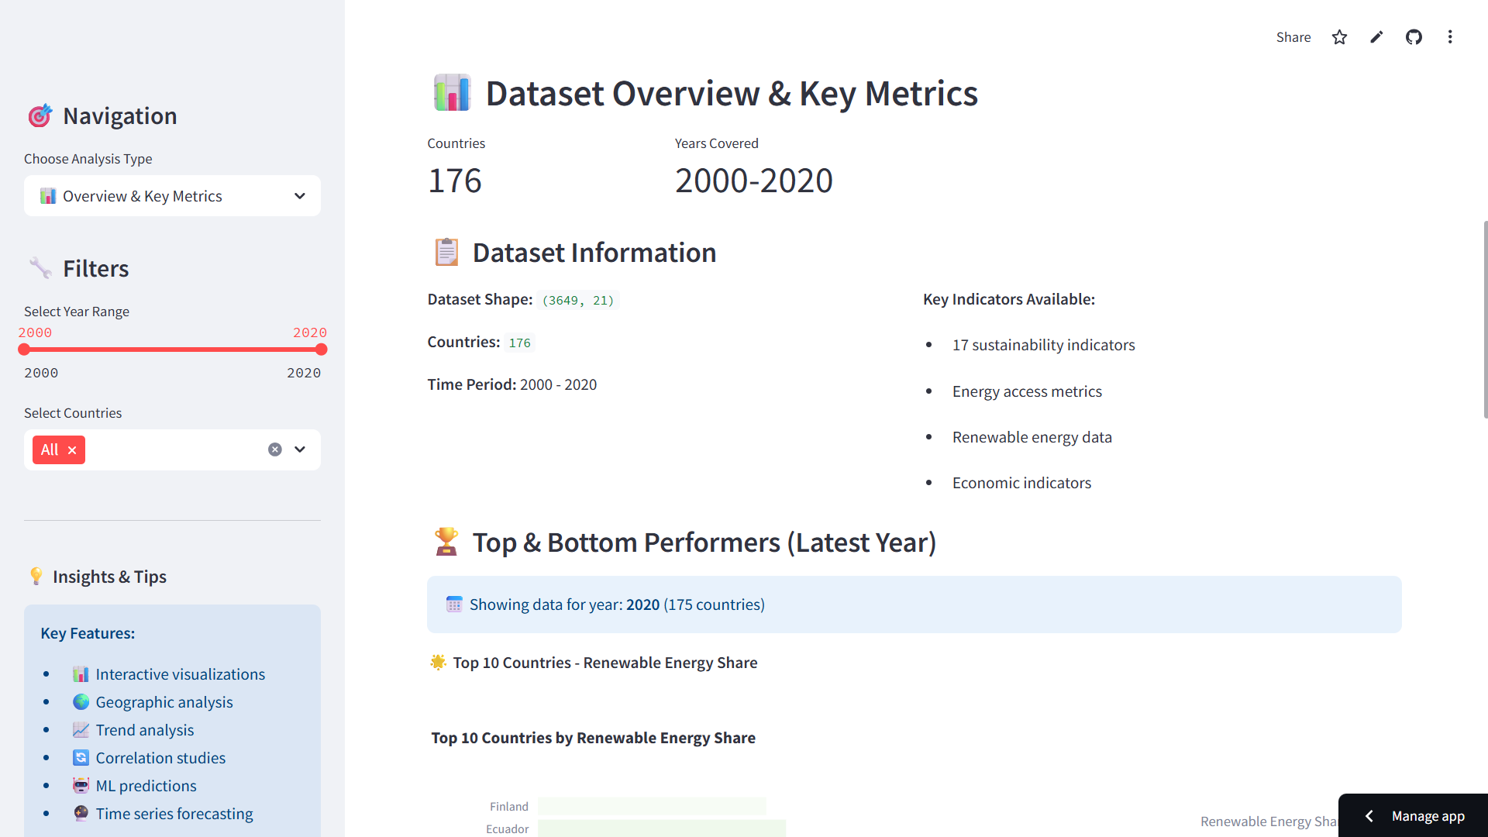
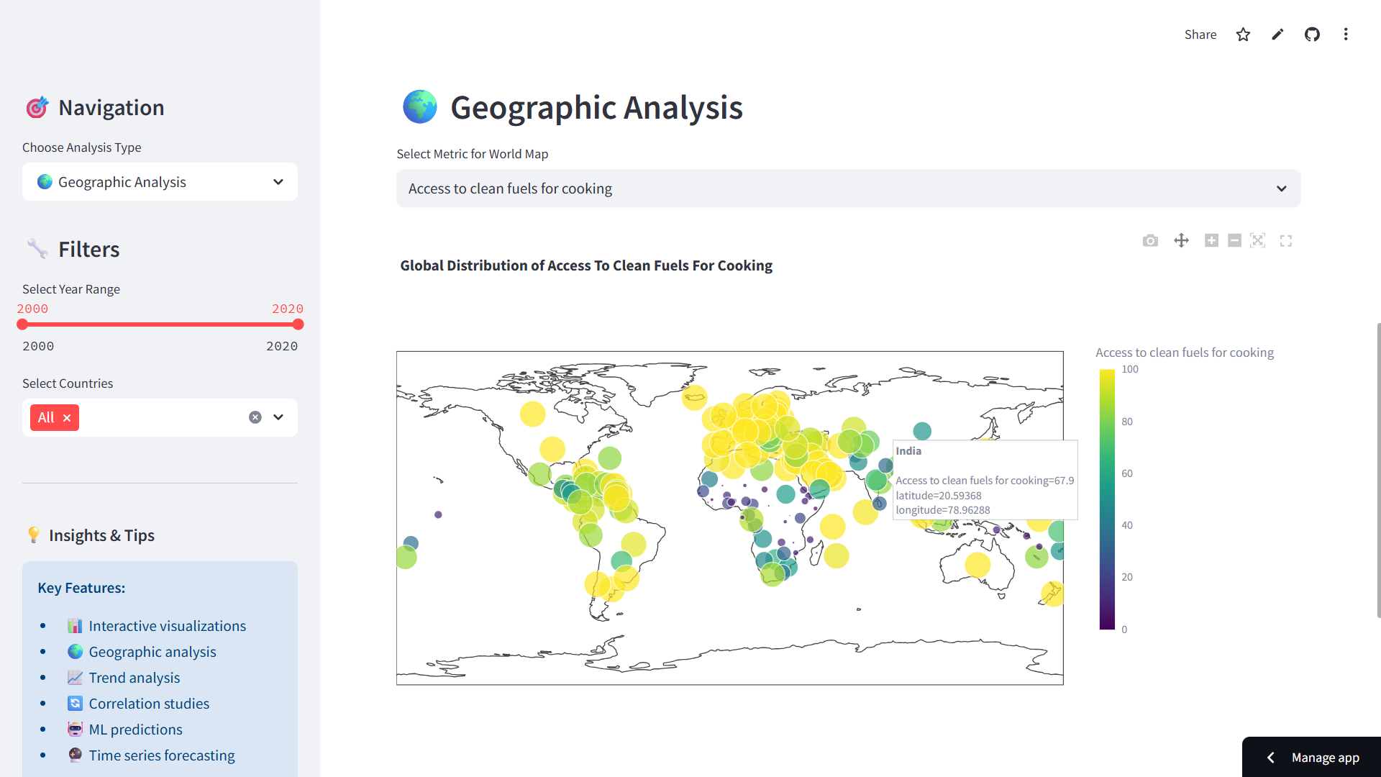
Screenshots of Output:

Slide 9
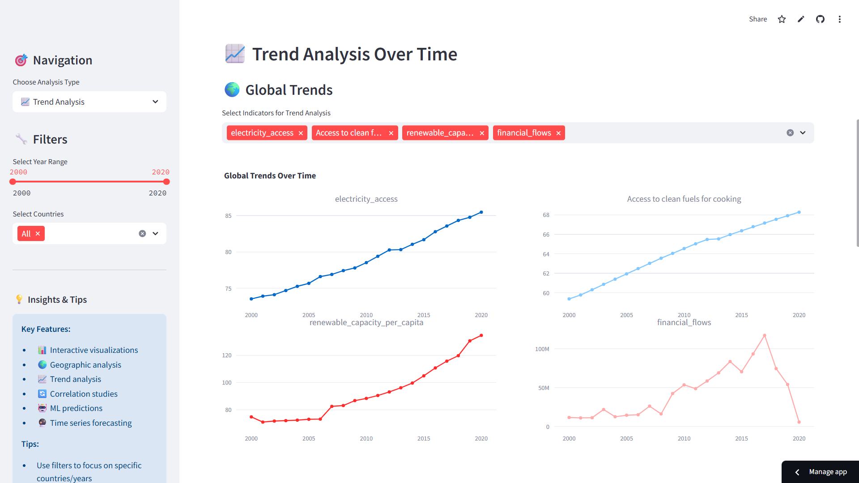
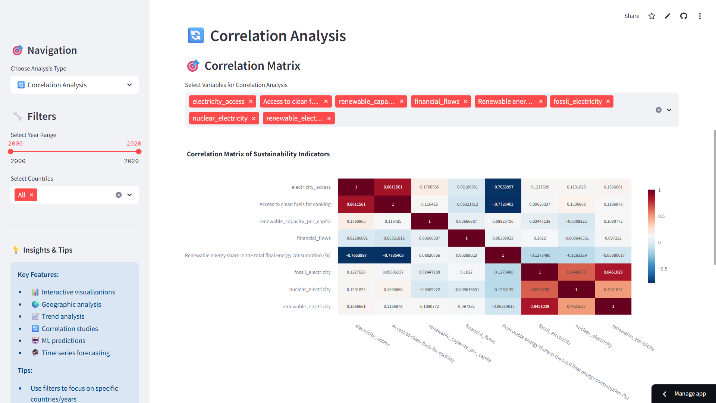
Screenshots of Output:

Slide 10
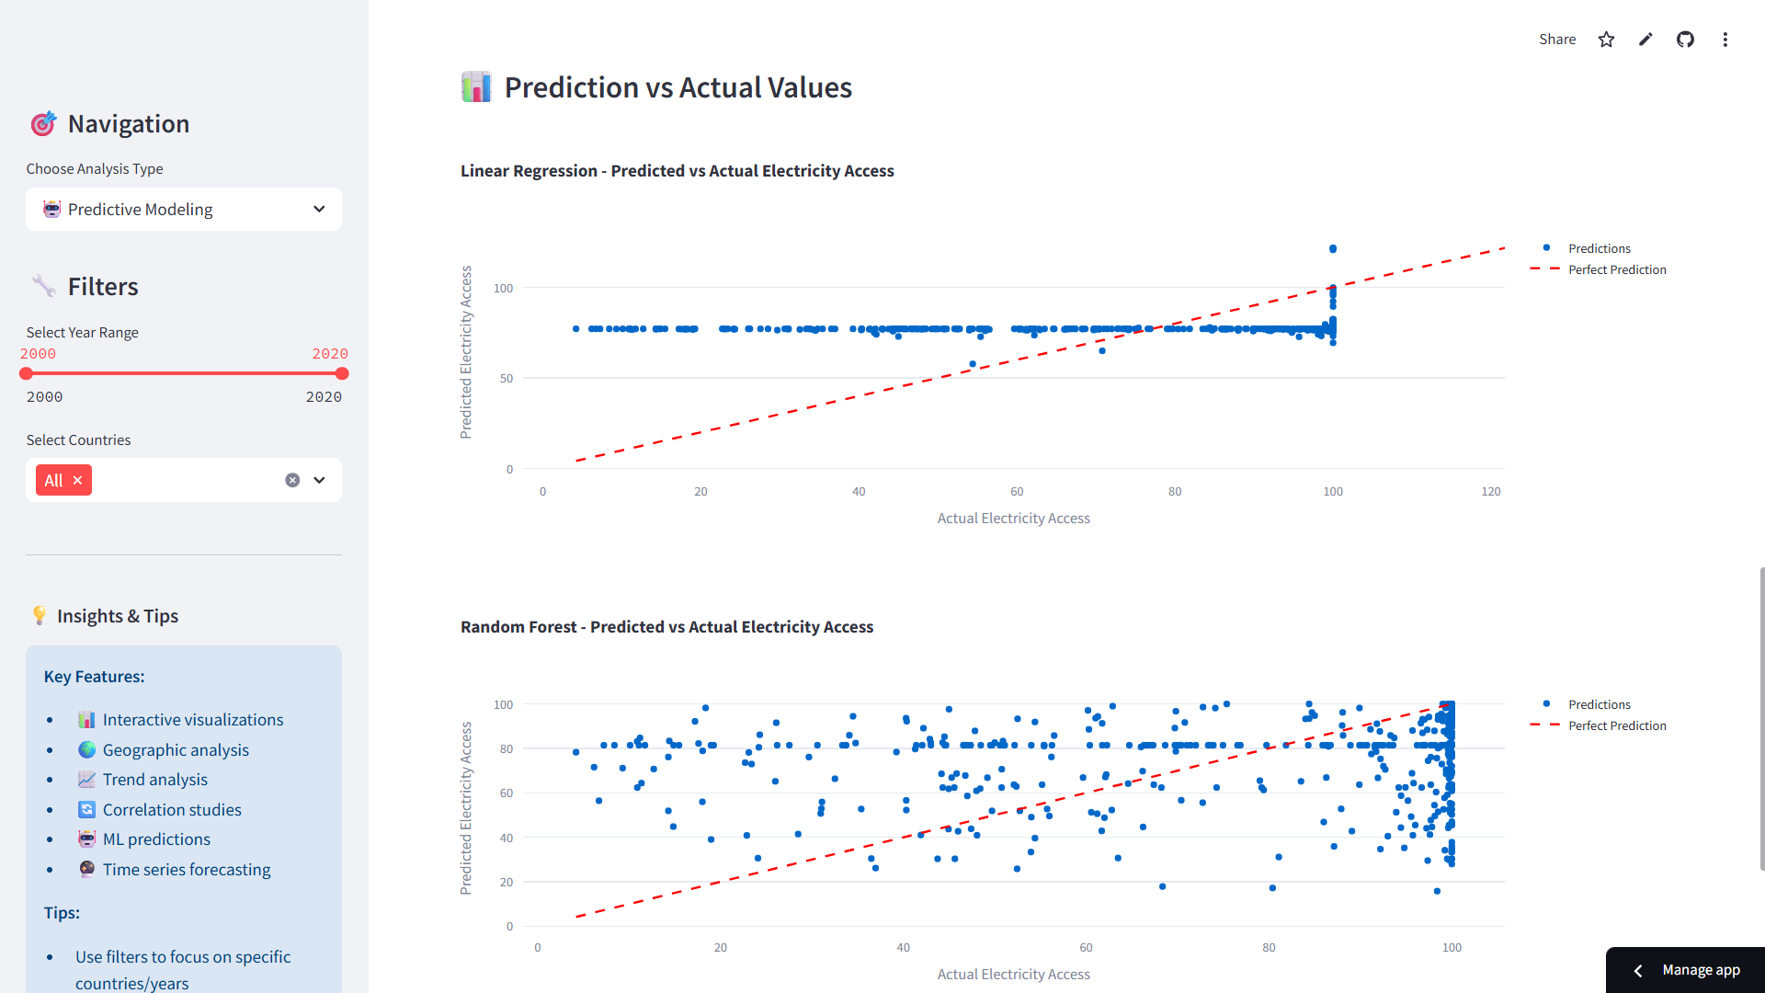
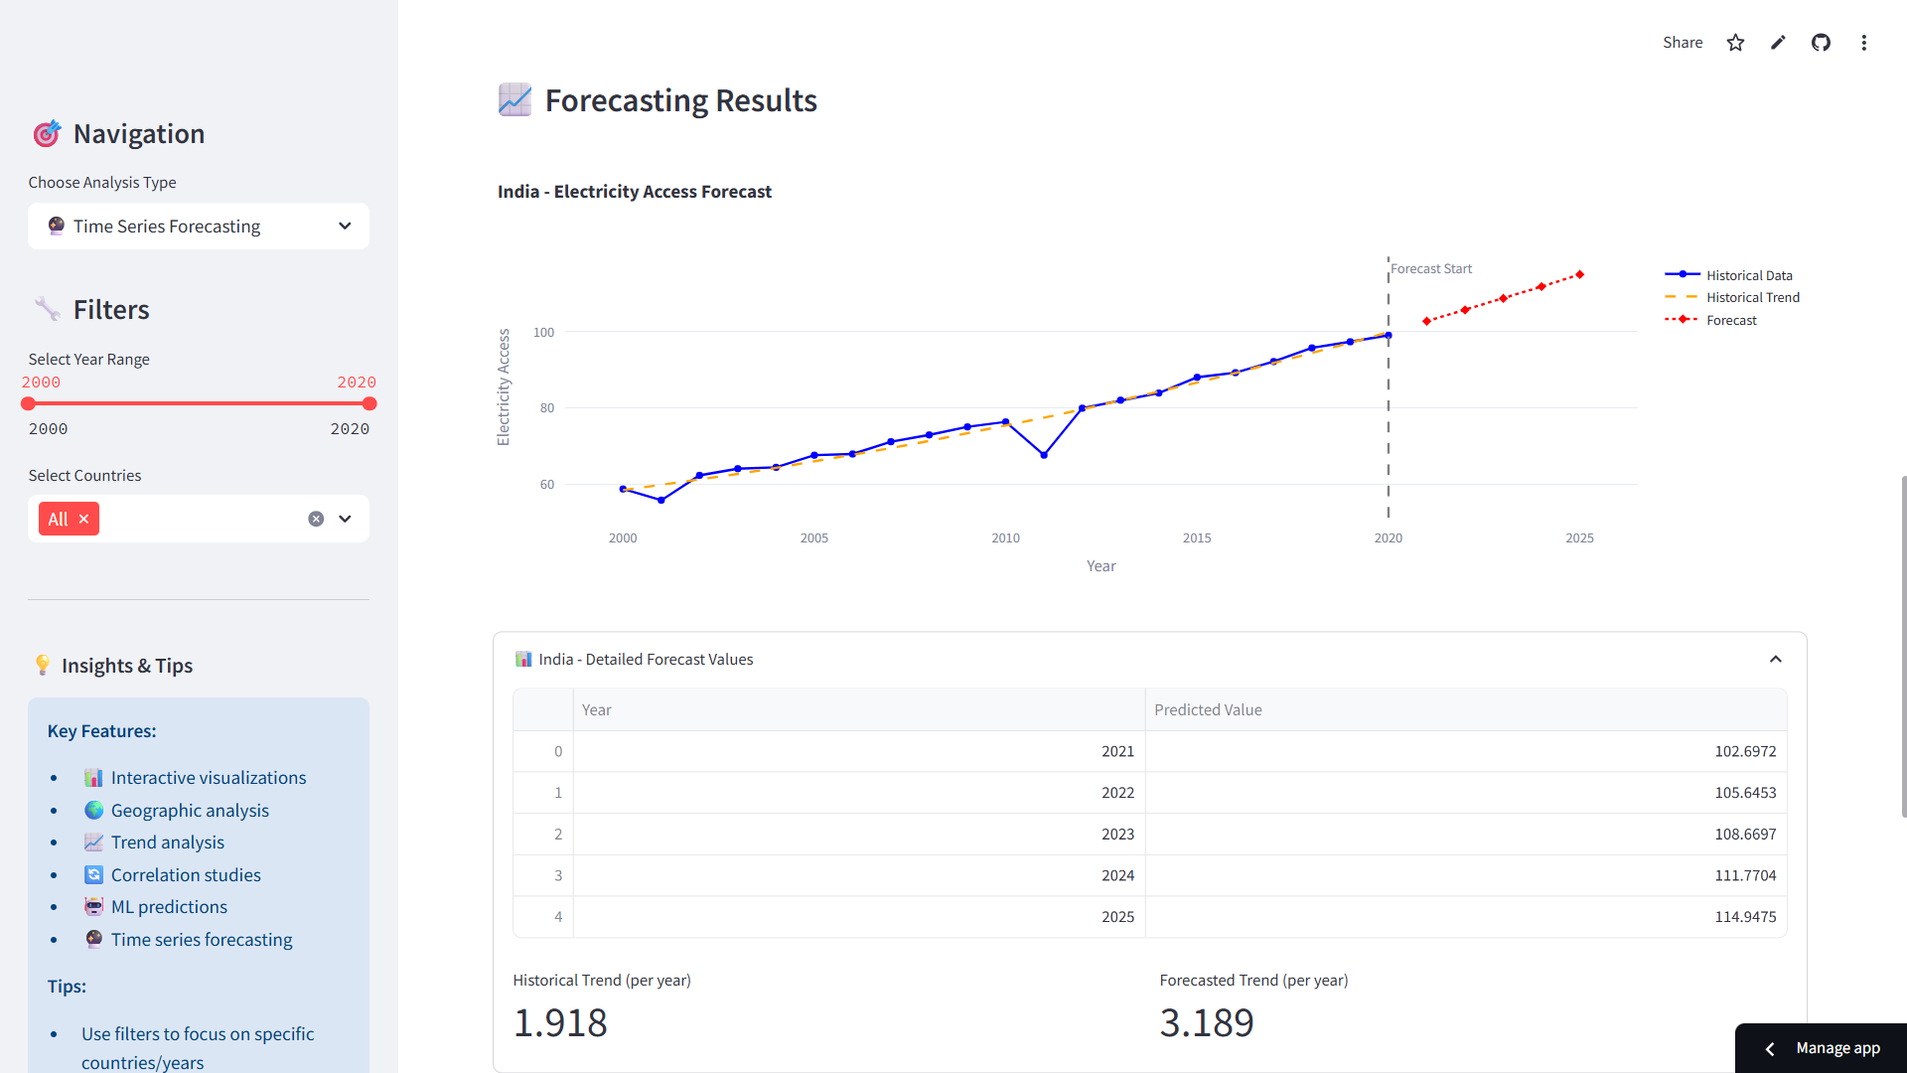
Screenshots of Output:

Slide 11
Conclusion:
The EcoVision Analytics project successfully demonstrates the power of combining advanced data science, machine learning, and web development to address real-world sustainability challenges. By transforming complex energy data into accessible insights, the platform bridges the critical gap between information availability and actionable intelligence.
This project exemplifies applied learning at its best, integrating theoretical knowledge from multiple disciplines into a practical solution with genuine impact potential. The comprehensive approach—from data preprocessing to cloud deployment—provides invaluable experience in modern data science workflows.
Beyond technical achievement, EcoVision Analytics contributes to the broader mission of democratizing sustainability analytics, making sophisticated tools accessible to researchers, policymakers, and advocates working toward a sustainable future.
🔮 Future Applications & Extensions
📊 Immediate Applications
Government: Policy analysis and climate strategy development
Corporate: ESG reporting and sustainability benchmarking
Academic: Research platform and educational tool
NGOs: Advocacy and public awareness campaigns
🚀 Platform Evolution
Advanced AI: Deep learning and natural language processing
Real-Time Integration: Live data feeds and automatic updates
Global Expansion: Multi-language support and regional customization
Mobile Enhancement: Dedicated mobile applications
EcoVision Analytics successfully transforms the challenge of sustainability data complexity into an opportunity for informed decision-making, demonstrating how technology can accelerate progress toward global climate goals.

Slide 12
References:
https://sdgs.un.org/goals
https://www.kaggle.com/datasets/anshtanwar/global-data-on-sustainable-energy
Deployed Project Link:
https://ecovision-sustainable-energy-analytics-platform-ssmp.streamlit.app/
Github Repository Link:
https://github.com/Shreyas521032/EcoVision-Sustainable-Energy-Analytics-Platform

